Slide 1

Marist Syllabus Evaluator
A Software Application
Developers: Chris Crawley, Emily Doran, Tommy Burda
IT Professional/Designer: Brendan Bartow
Project Manager: Abel Simon
"It's pretty good!" - Professor Glomski

Slide 2

Why Is The System Useful?
Automate the syllabi validation process
2

Slide 3
Why Is The System Useful?
Automation
Eases the job of the Marist Curriculum Committee's members
One Stop Syllabus Suite
Create and/or validate syllabi in the system
High Functionality
Offers complimentary that features faculty will enjoy

Slide 4
Functional Requirements
Allow users to login securely
Accept pdf, docx, and pages files
Score syllabi based on missing elements
Analyze syllabi sentiment
Viewable sample syllabi
Admins accounts with elevated privileges
Syllabi creation
Store syllabi in the system

Slide 5
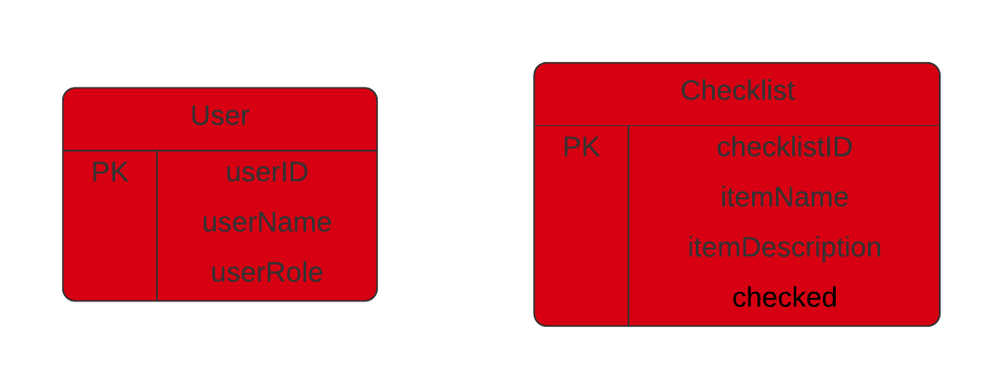
Entity Relationship Diagram
Database is hosted as DB2 on Cloud
User role retrieved from database to determine access level (admin / user)
Checklist entity used to determine items they're graded by, modifiable by admins

Slide 6
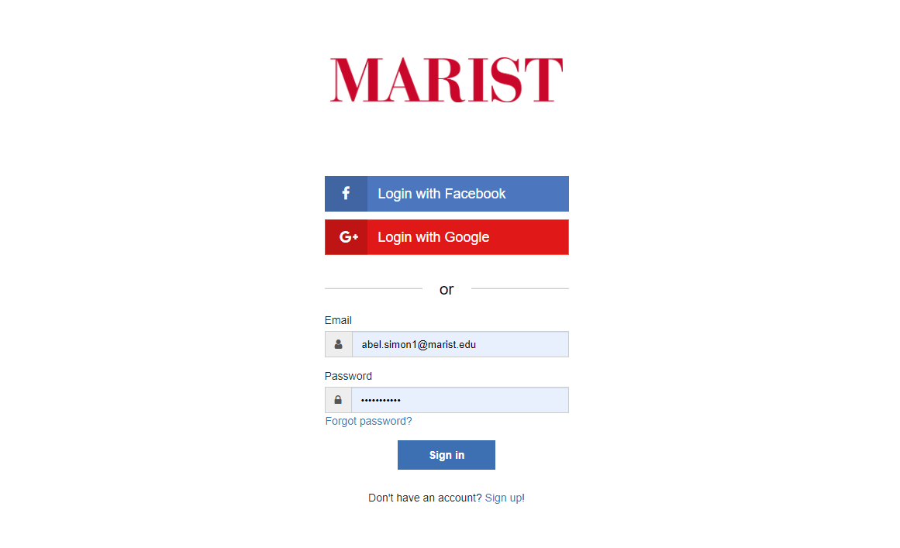
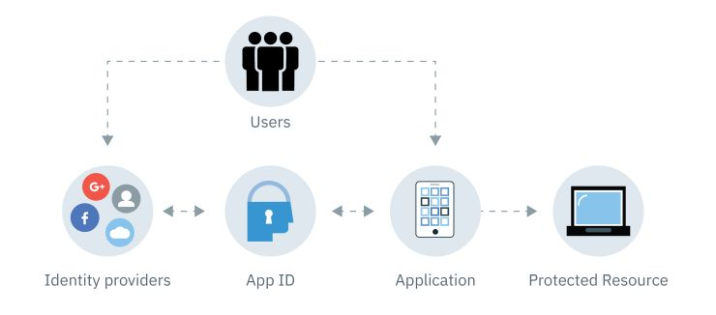
Login & Security
IBM App ID Service for Authentication
Node.js integration using Passport
Sign up to create an account in Cloud Directory, or login with Google/Facebook Login using Google or Facebook
User email and role are stored in database

Slide 7
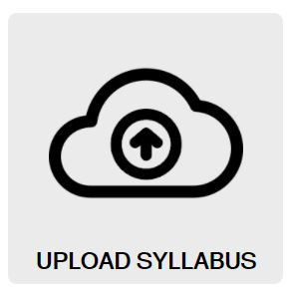
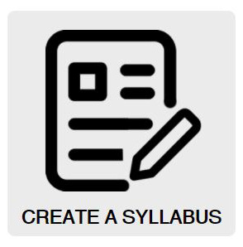
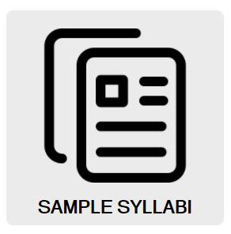
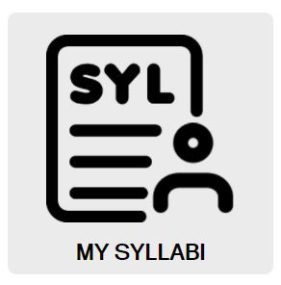
Normal User Feature Overview
Upload Syllabus For Analysis
Build Syllabus From Scratch
View Example Syllabi
Save Syllabi To Your Account

Slide 8
Syllabus Evaluation
Basics
The keyword analysis is done on the backend in Python
Python was decided on because of its speed relative to JavaScript
Each item required in the syllabus is listed as a key in a dictionary that leads to an array of regex expressions to search for each item
The program then loops though every search for every item in every line of the syllabus converted to a .txt
Level 1: Basic keywords
For some items just a keyword search in the keyword search was adequate
Teachers all use different wording for different requirements so many keywords are needed for each item
Ex: Academic Honesty:
Searches: "academic honesty" , "cheating" , "plagiarism"

Slide 9
Syllabus Evaluation (cont.)
Level 2: Regex Searches
Some items were specific to each class and weren't surrounded by any relevant keywords
For these we had to find creative ways to search for them through regex commands
Ex: course code
Search:
"[0-9]{3}( |_)*(N|L|n|l)( |_)*[0-9]{3}"
Level 3: Special cases
For some items there were no universal regex searches that could be hard coded into the system
For these we had to add special code to add specialized searches after initially reading the syllabus
Ex: Instructors name
Looked for "@marist.edu" then parsed for prof name in e-mail and added that expression to the array for instructor's name
Any 3 digits
_ or space
_ or space
Any 3 digits
N or L
475_N_113

Slide 10
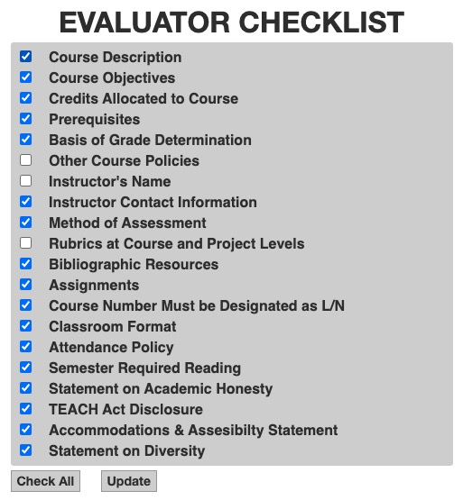
Admin Privileges - Checklist
Admins are able to modify checklist of search requirements
Only selected items will be searched and scored during syllabus evaluation
Users cannot access this checklist
Affects grading

Slide 11
Sample Syllabi
Users can view a selection of sample syllabi
Samples have been run through system and scored grades of B or higher
Syllabi can be downloaded or viewed in browser depending on file type
Majority of requirements are fulfilled in these syllabi

Slide 12
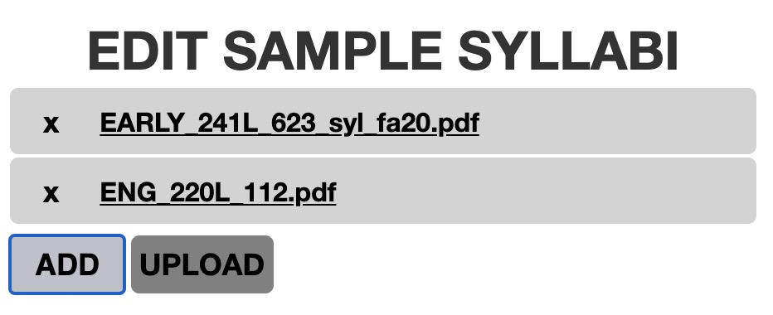

Admin Privileges - Sample Syllabi
Admins are able to modify selection of sample syllabi viewable to users
Samples are stored in Cloud Object Store bucket
Accepts .doc, .docx, .pdf, .pages file types

Slide 13
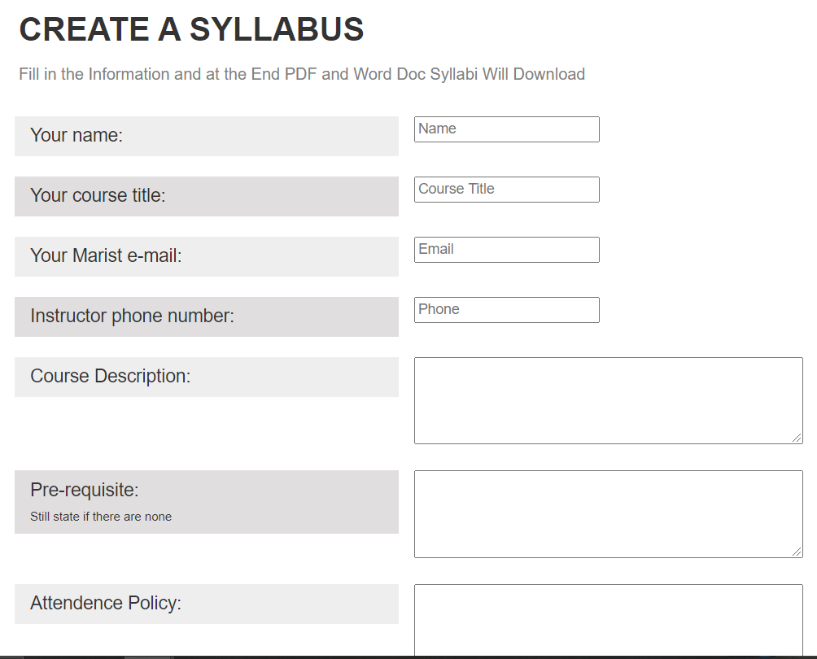
Create Syllabus From Template
Users have the ability to create their syllabus on the syllabus evaluator website
We provide a template with all the required items given thier own text boxes
Once the template is filled out the users can choose to download their syllabus as a fully formatted PDF or just the text in a word document for them to design and add to themselves
The template is made entirely on the client side using the JSpdf and the DOCXjs libraries
Download as pdf, doc,
Select font and header image

Slide 14
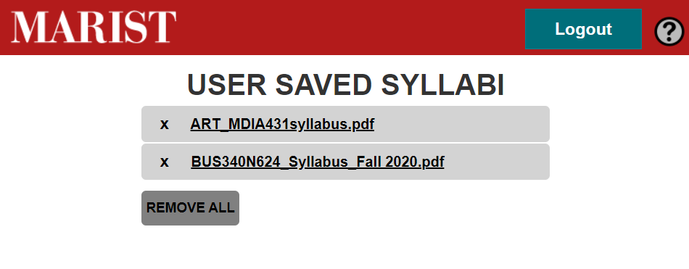
User Syllabi
The system also includes a page where all users can view and edit their previously submitted syllabi
Users can also download their syllabi from this page
Each user has a dedicated 'bucket' in the Cloud Object Store for simple retrieval of their stored syllabi

Slide 15
Additional Features
Sentiment Analysis:
Using the natural npm package, we are able to utilize the Sentiment Analysis function in order to get a read on the Sentiment of the Syllabus
The sentiment analysis is based on a simple algorithm that assigns polarity to words.
If a statement is negative it will return a negative sentiment, if a statement is positive it will return a positive sentiment.
We then normalize this value to fit on a 0-100 scale, 0 being a low or negative sentiment, 100 being a high or positive sentiment

Slide 16
Additional Features
Spellchecker:
Using the spell-checker-js npm package we are able to find misspelled words.
Spell-checker-js uses two dictionaries to check for words. The English dictionary provided with the package, and a custom dictionary with uncommon words that aren't in the provided English dictionary.
The spellchecker function then compares the syllabi against the two dictionary to see if any of the words are misspelled.
If a word is misspelled we return it to the results page.

Slide 17
Additional Features
Hosted as IBM Cloud Foundry Application, Instructions for easy Docker installation, Smartphone functionality

Slide 18
Demo: Cloud Site
https://syllabus-eval.us-south.cf.appdomain.cloud/

Slide 19
Thank You
Questions?

